Slide 1
Digital Twin of Mass-Spring-Damper System Using System Identification
Agus Hasan

Slide 2
Outline
Introduction: What is Digital Twin?
Development of digital twin for mass-spring-damper system using system identification
Modeling
Visualization
Simulation
Shadow Twin
Digital Twin
+ system identification → “the engine” for digital twin
+ Commercial Off The Shelf (COTS) Software

Slide 3
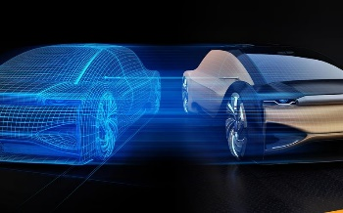
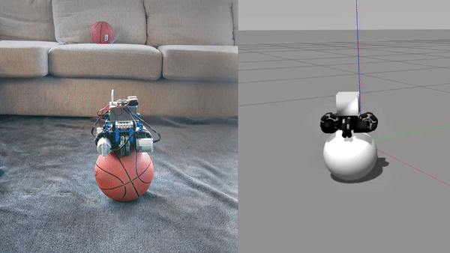
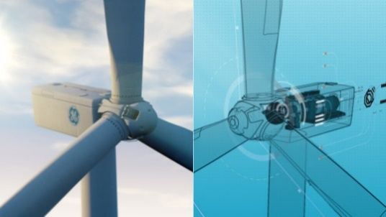
What is Digital Twin?
A digital twin is a digital replica of
a living or non-living physical entity
Main characteristic: connectivity
(via the cloud, Bluetooth, wifi, etc…)
It can be used for:
Predictive maintenance
Condition monitoring
Product design
Physical twin Digital twin
Modeling
Visualization
Simulation
Shadow Twin
Digital Twin
A. Hasan, eXogenous Kalman filter for state and parameter estimation in autonomous ball-balancing robot, IEEE/ASME International Conference on Advanced Intelligent Mechatronics, Boston, USA, 2020

Slide 4
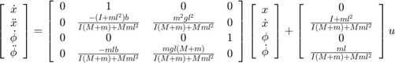
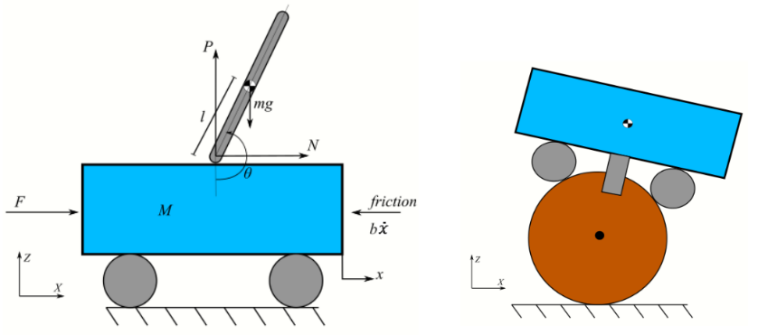
What is Digital Twin?
A digital twin is a digital replica of
a living or non-living physical entity
Main characteristic: connectivity
(via the cloud, Bluetooth, wifi, etc…)
It can be used for:
Predictive maintenance
Condition monitoring
Product design
Physical twin Digital twin
Modeling
Visualization
Simulation
Shadow Twin
Digital Twin
A model consists of:
States (known via sensors)
Parameters (unknown)
Uncertainties
System identification is a process
of estimating states and parameters
of dynamical systems from limited
number of measurement under uncertainties

Slide 5
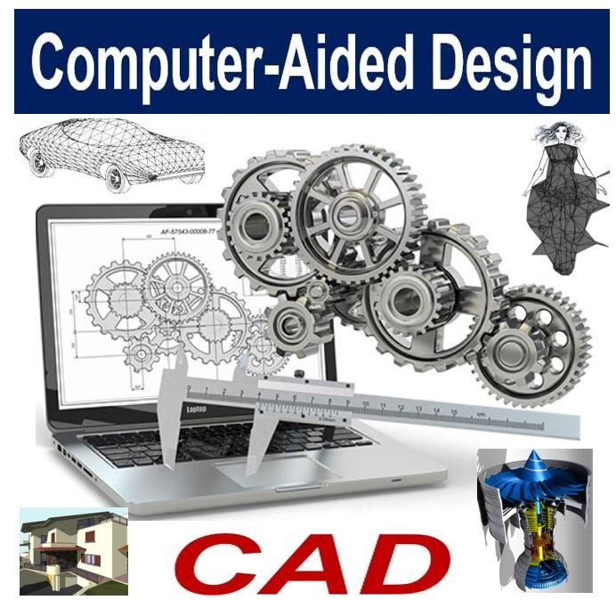
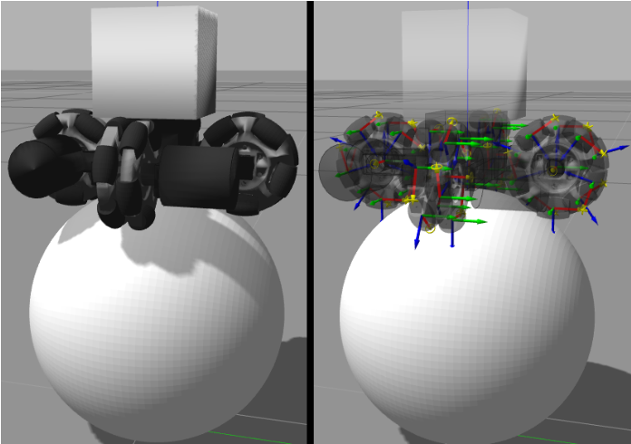
What is Digital Twin?
A digital twin is a digital replica of
a living or non-living physical entity
Main characteristic: connectivity
(via the cloud, Bluetooth, wifi, etc…)
It can be used for:
Predictive maintenance
Condition monitoring
Product design
Physical twin Digital twin
Modeling
Visualization
Simulation
Shadow Twin
Digital Twin
Software:
AutoCAD
CATIA
Fusion 360
Creo
OnShape
FreeCAD

Slide 6
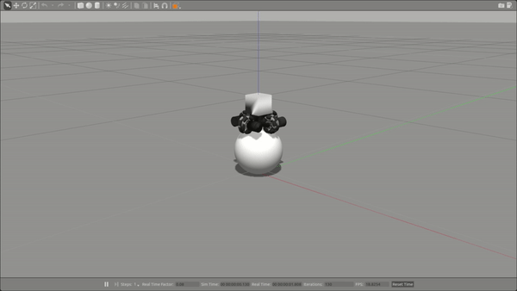
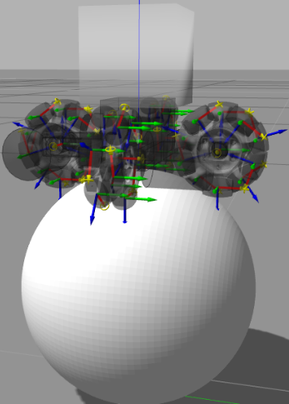
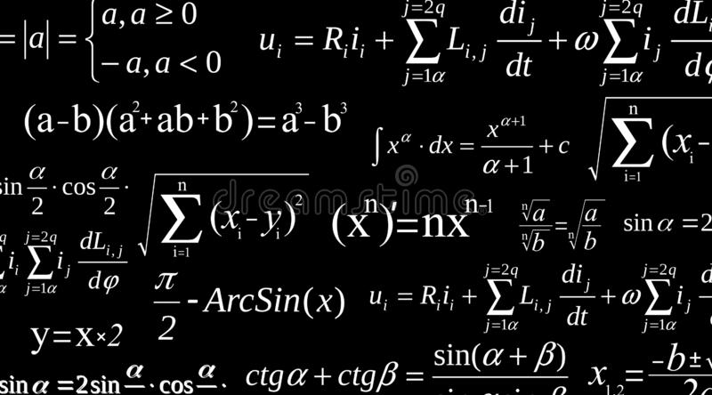
What is Digital Twin?
A digital twin is a digital replica of
a living or non-living physical entity
Main characteristic: connectivity
(via the cloud, Bluetooth, wifi, etc…)
It can be used for:
Predictive maintenance
Condition monitoring
Product design
Physical twin Digital twin
Modeling
Visualization
Simulation
Shadow Twin
Digital Twin
Computer
Software:
Matlab
Gazebo
TeamCenter
VeroSim
Mathematical Model
System identification
algorithm

Slide 7
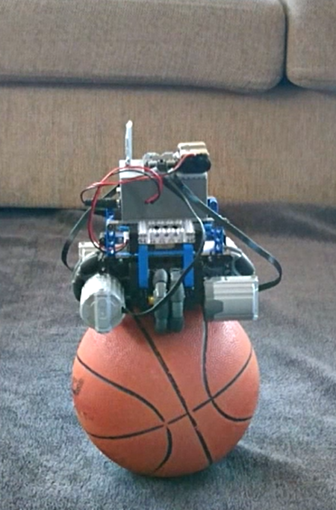
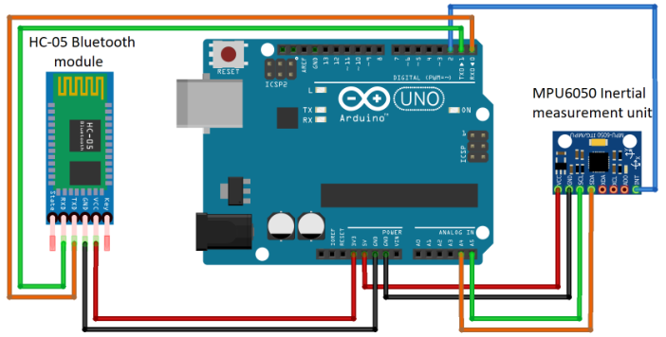
What is Digital Twin?
A digital twin is a digital replica of
a living or non-living physical entity
Main characteristic: connectivity
(via the cloud, Bluetooth, wifi, etc…)
It can be used for:
Predictive maintenance
Condition monitoring
Product design
Physical twin Digital twin
Modeling
Visualization
Simulation
Shadow Twin
Digital Twin
data
event and actions
Communication

Slide 8
What is Digital Twin?
A digital twin is a digital replica of
a living or non-living physical entity
Main characteristic: connectivity
(via the cloud, Bluetooth, wifi, etc…)
It can be used for:
Predictive maintenance
Condition monitoring
Product design
Physical twin Digital twin
Modeling
Visualization
Simulation
Shadow Twin
Digital Twin

Slide 9
Outline
Introduction: What is Digital Twin?
Development of digital twin for mass-spring-damper system using system identification
Modeling
Visualization
Simulation
Shadow Twin
Digital Twin
+ system identification → “the engine” for digital twin
+ Commercial Off The Shelf (COTS) Software

Slide 10
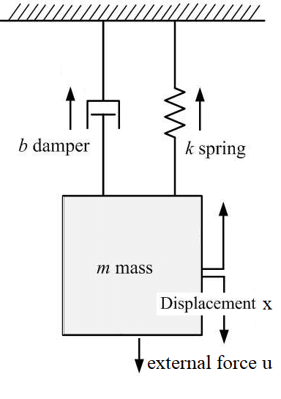
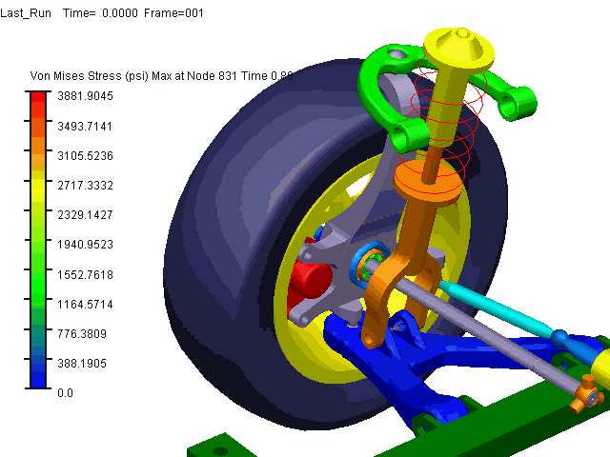
Mass-Spring-Damper System
Double wishbone suspension

Slide 11

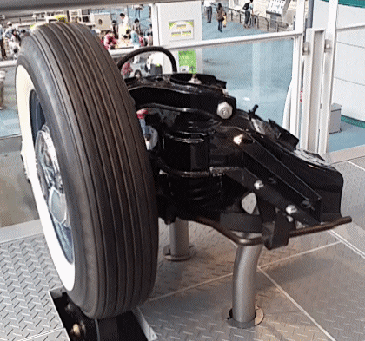
data
event and actions
adjustment/recommendation
Modeling
Visualization
Simulation
Shadow Twin
Digital Twin

Slide 12

data
event and actions
adjustment/recommendation
Modeling
Visualization
Simulation
Shadow Twin
Digital Twin
Black-box model
No prior model is available
Data driven modeling
Autoregresive exogenous model
Low accuracy
Grey-box model
First principle (eq. of motion)
Some parameters are unknown
Data and physics driven modeling
Extended Kalman filter
High accuracy
White-box model
First principle (eq. of motion)
Physics-based modeling
Assuming parameters are known
High accuracy

Slide 13
data
event and actions
adjustment/recommendation
Modeling
Visualization
Simulation
Shadow Twin
Digital Twin
System Identification
Derive the equation of motion
Determine the state-space representation
Determine the measurement vector
Calculate the Jacobian matrix
Implement Extended Kalman filter

Slide 14
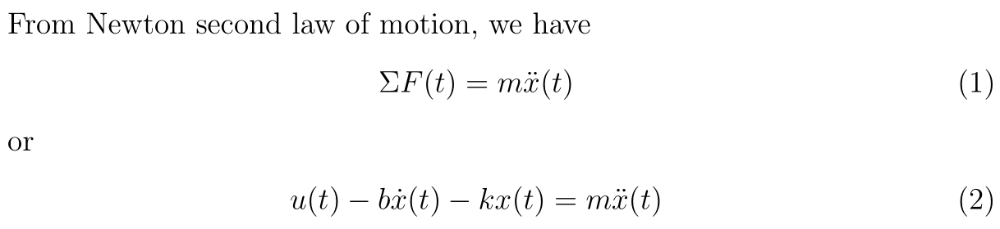
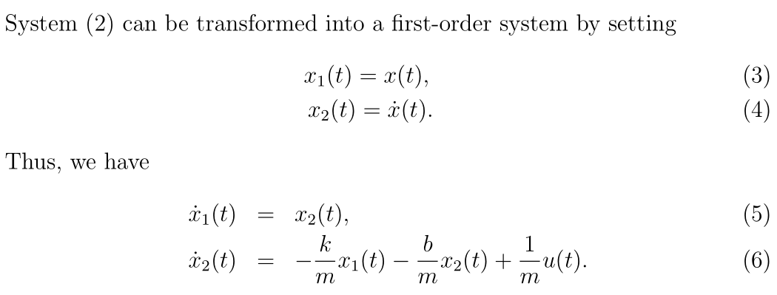
Modeling
Visualization
Simulation
Shadow Twin
Digital Twin
Derive the equation of motion
Determine the state-space representation
Determine the measurement vector
Calculate the Jacobian matrix
Implement Extended Kalman filter
https://github.com/agusisma/smd

Slide 15
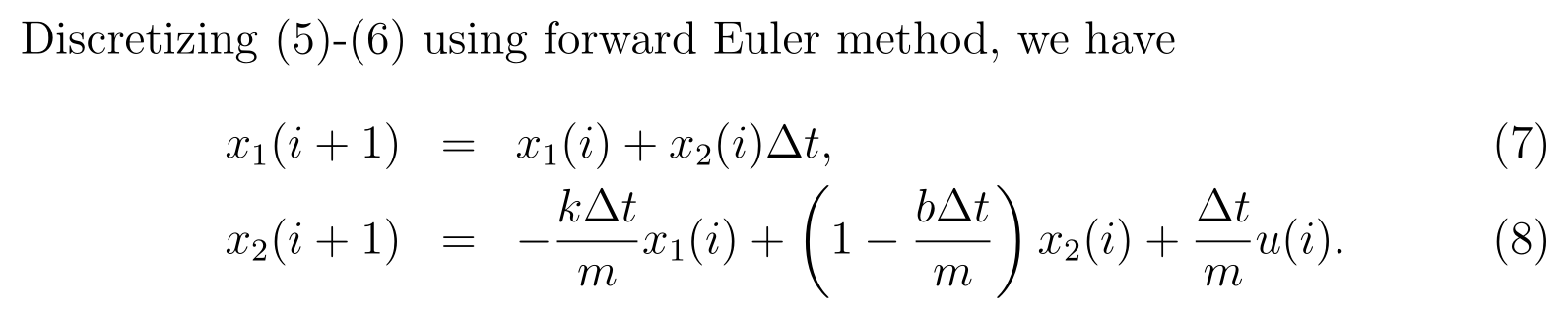
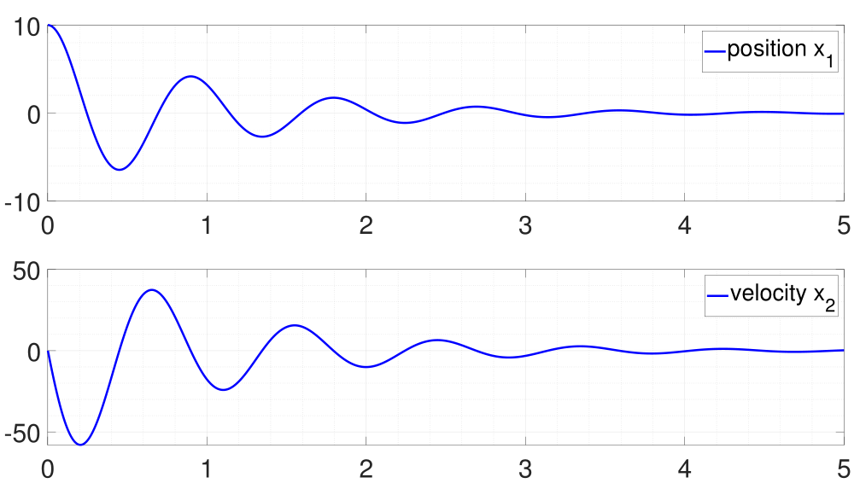
Modeling
Visualization
Simulation
Shadow Twin
Digital Twin
Derive the equation of motion
Determine the state-space representation
Determine the measurement vector
Calculate the Jacobian matrix
Implement Extended Kalman filter
https://github.com/agusisma/smd

Slide 16
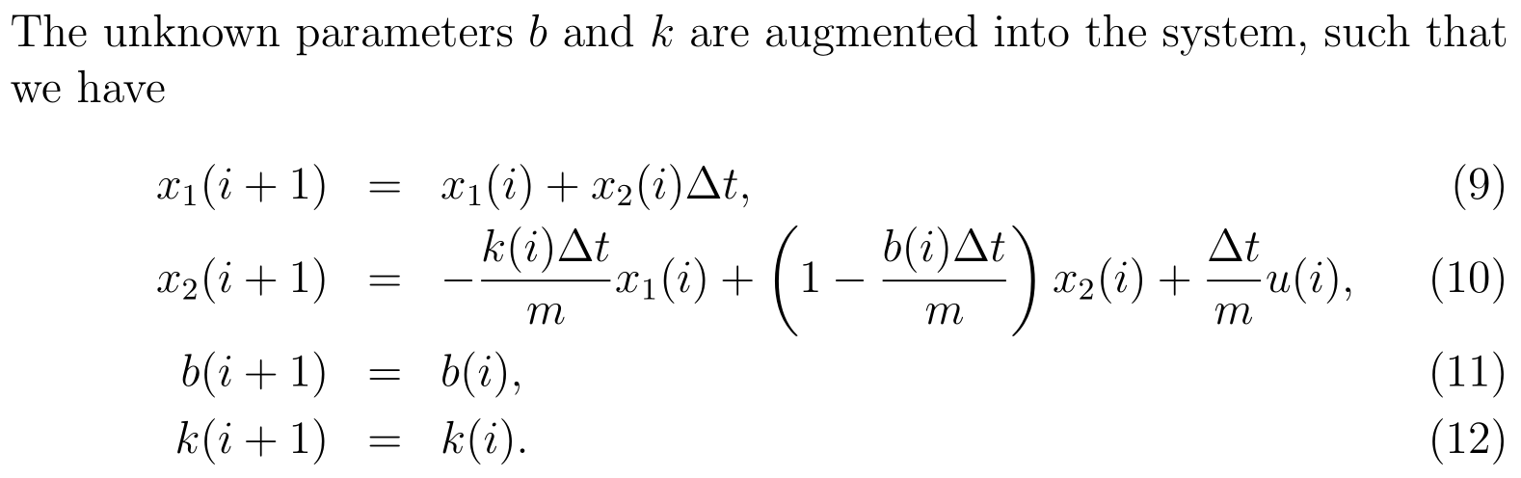
Modeling
Visualization
Simulation
Shadow Twin
Digital Twin
System Identification
Derive the equation of motion
Determine the state-space representation
Determine the measurement vector
Calculate the Jacobian matrix
Implement Extended Kalman filter
System Identification problem:
What we know:
Displacement (measured using an ultra-wideband sensor)
Velocity (measured using an accelerometer)
What we don’t know:
Damper coefficient (b)
Spring coefficient (k)
https://github.com/agusisma/smd

Slide 17
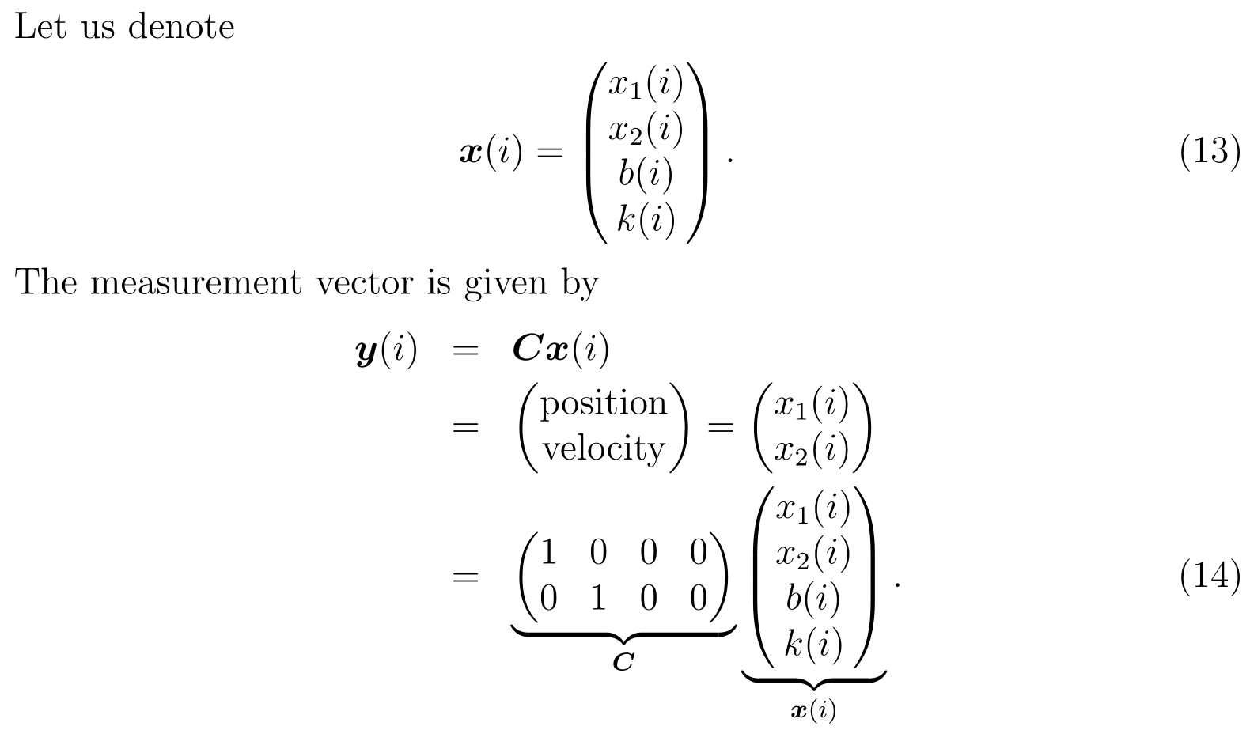
Modeling
Visualization
Simulation
Shadow Twin
Digital Twin
System Identification
Derive the equation of motion
Determine the state-space representation
Determine the measurement vector
Calculate the Jacobian matrix
Implement Extended Kalman filter
https://github.com/agusisma/smd

Slide 18
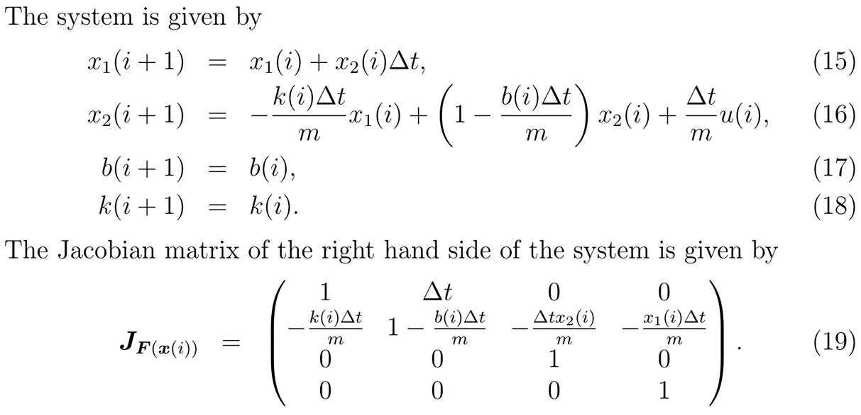
Modeling
Visualization
Simulation
Shadow Twin
Digital Twin
System Identification
Derive the equation of motion
Determine the state-space representation
Determine the measurement vector
Calculate the Jacobian matrix
Implement Extended Kalman filter
https://github.com/agusisma/smd

Slide 19
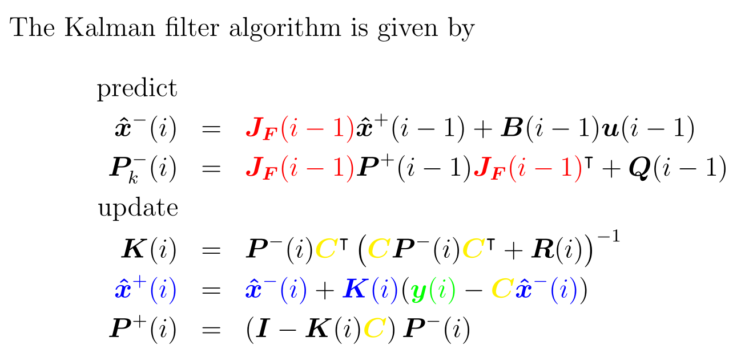
Modeling
Visualization
Simulation
Shadow Twin
Digital Twin
System Identification
Derive the equation of motion
Determine the state-space representation
Determine the measurement vector
Calculate the Jacobian matrix
Implement Extended Kalman filter
M. Skriver, J. Helck, and A. Hasan, Adaptive Extended Kalman Filter for Actuator Fault Diagnosis, IEEE International Conference on System Reliability and Safety, Rome, Italy, 2019.
https://github.com/agusisma/smd

Slide 20
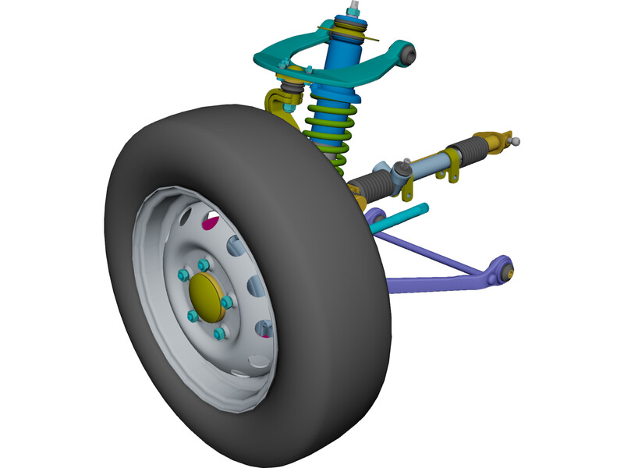
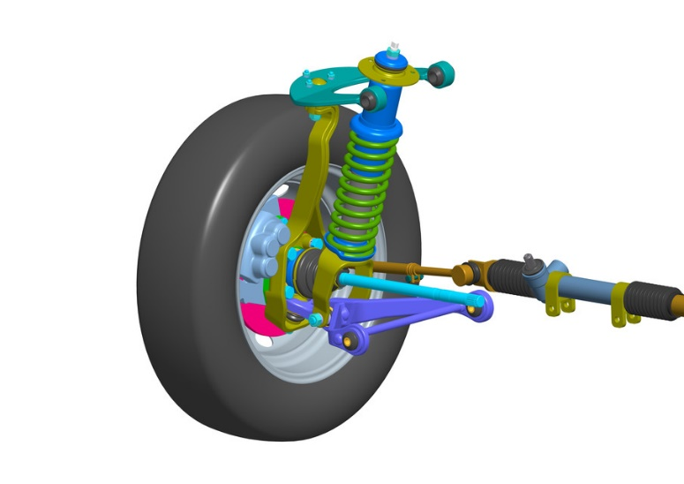
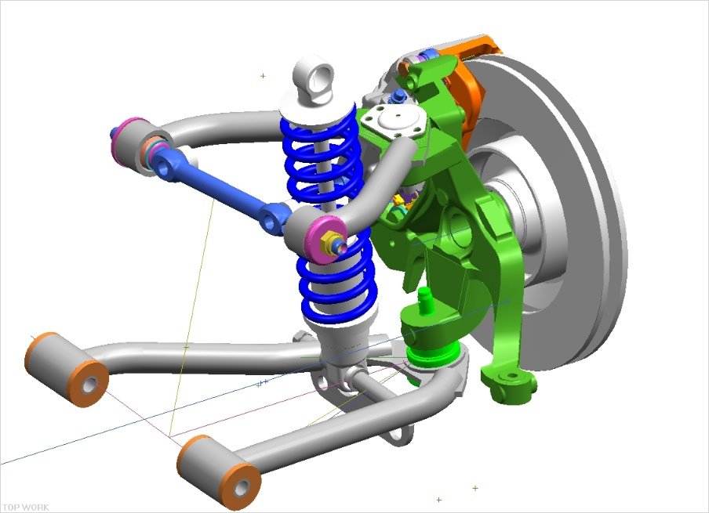
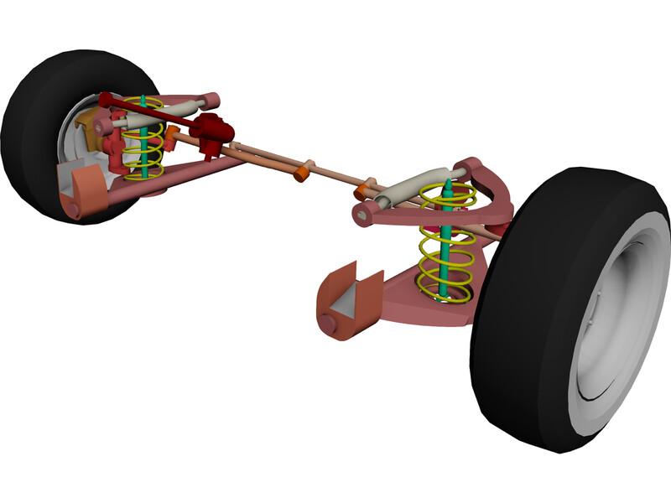
Modeling
Visualization
Simulation
Shadow Twin
Digital Twin

Slide 21

Modeling
Visualization
Simulation
Shadow Twin
Digital Twin
Computer
Mathematical model of mass-spring-damper system

Slide 22
Modeling
Visualization
Simulation
Shadow Twin
Digital Twin
data
event and actions

Slide 23
Modeling
Visualization
Simulation
Shadow Twin
Digital Twin
data
event and actions
adjustment/recommendation
predictive maintenance

